Slide 1
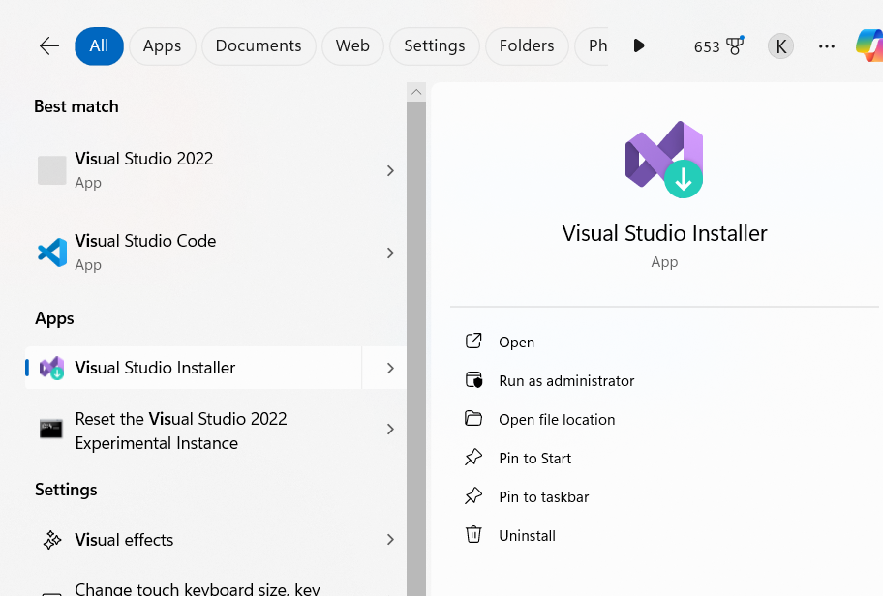
https://visualstudio.microsoft.com/downloads/
Down load Visual studio 22 for
Community edition (https://visualstudio.microsoft.com/downloads/)
Powerful IDE, free for students, open-source contributors, and individuals
After installation look for
Option Visual studio installer

Slide 2
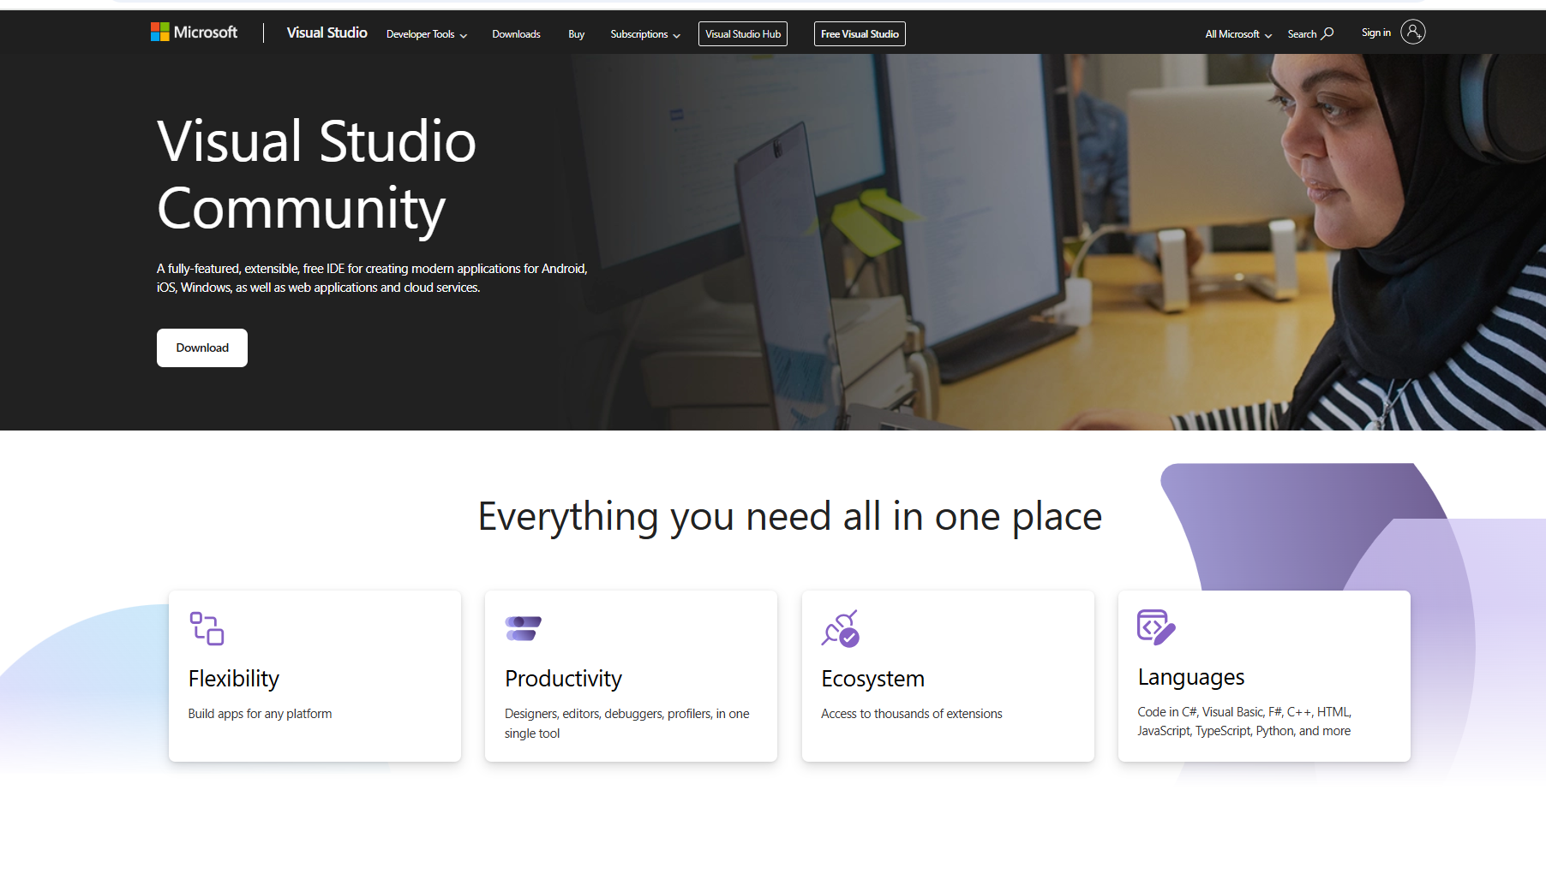
Click on download

Slide 3
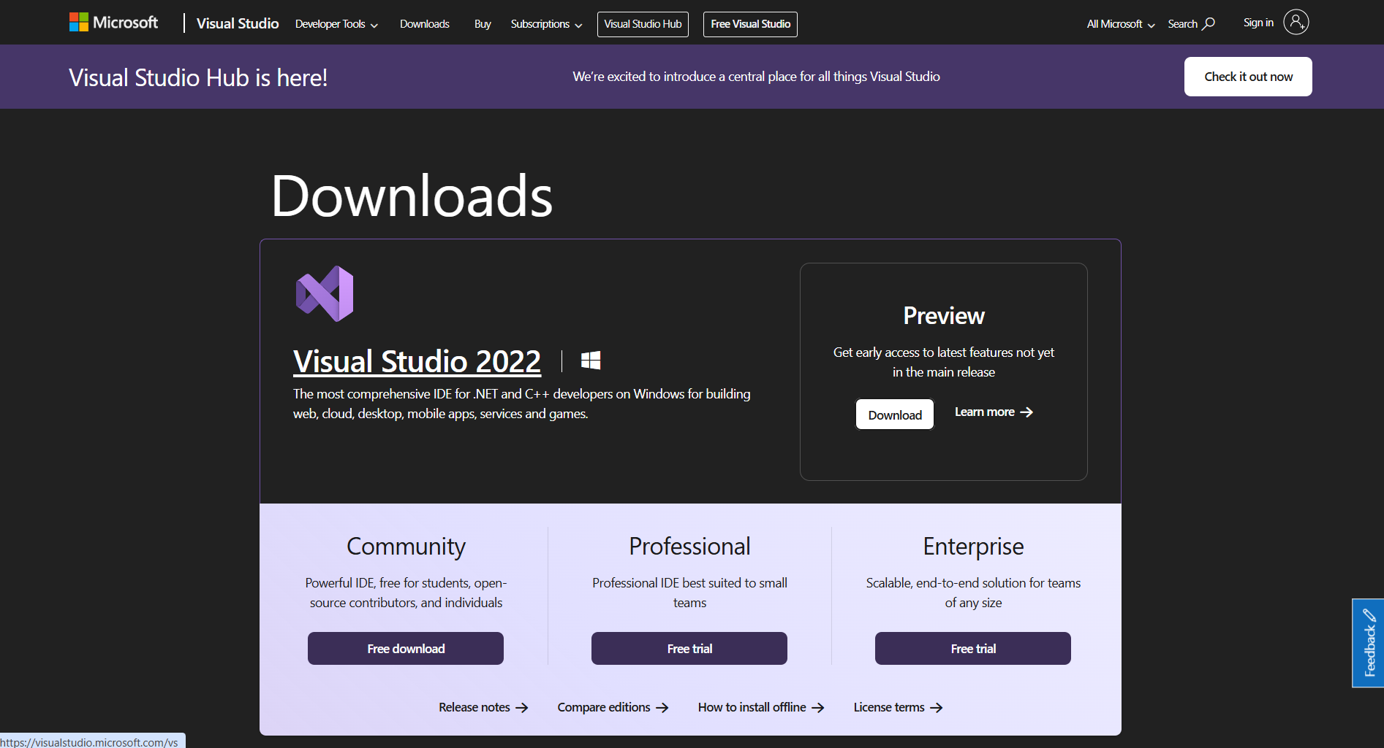
Click on community free down load

Slide 4
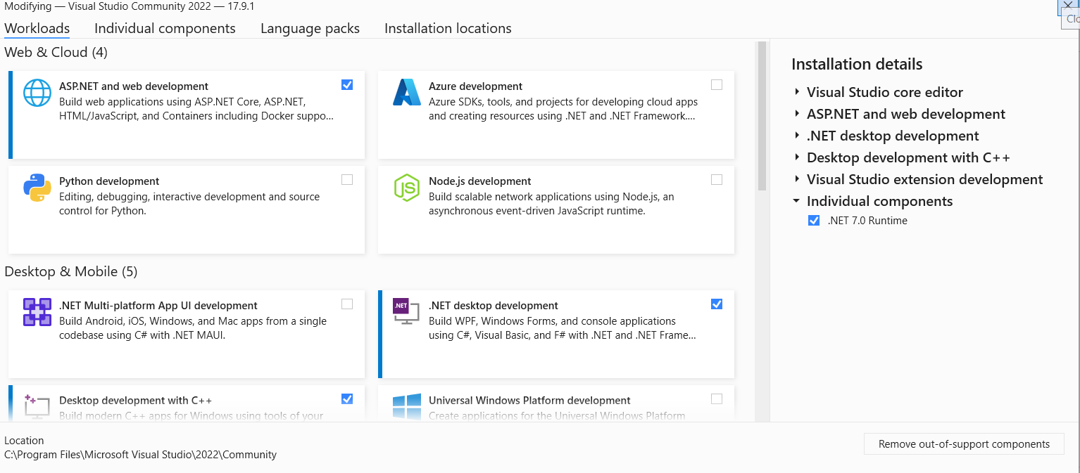
Click on modify and ensure that .Net 7.0 or above runtime is installed and
ASP.NET and web development is checked
.NET desktopdevelopment is checked

Slide 5
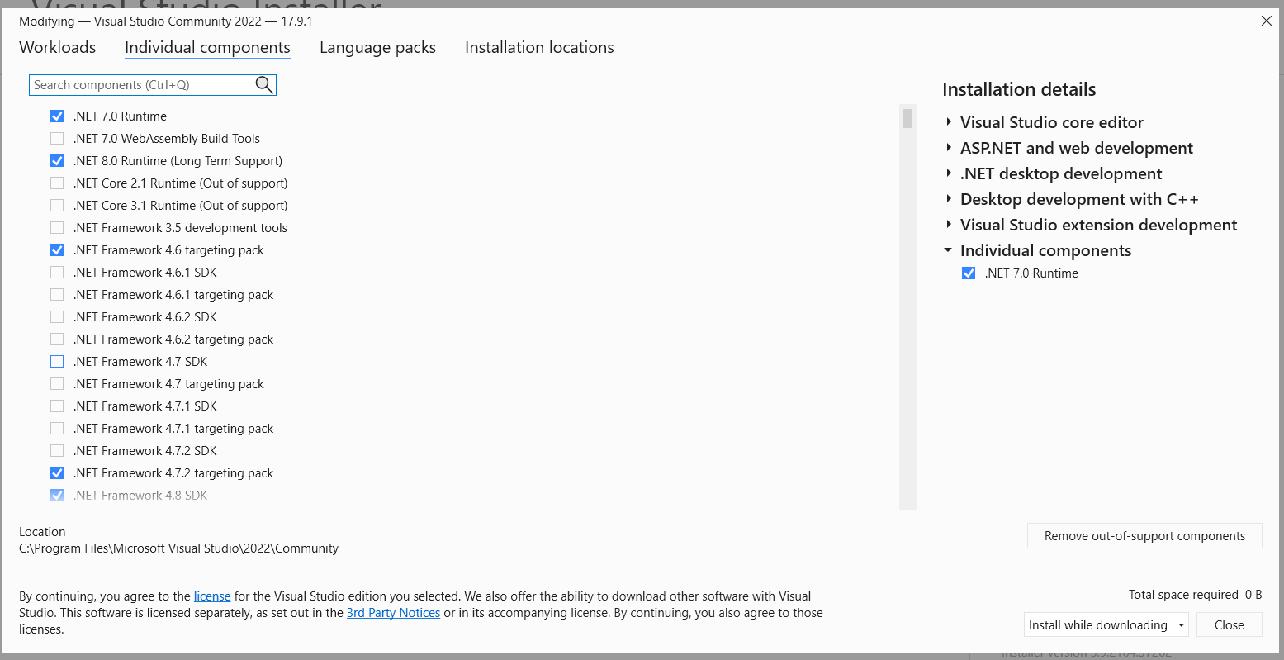
Click on individual component and check the option and checked it
Ensure .Net Framework SDK is also checked.

Slide 6
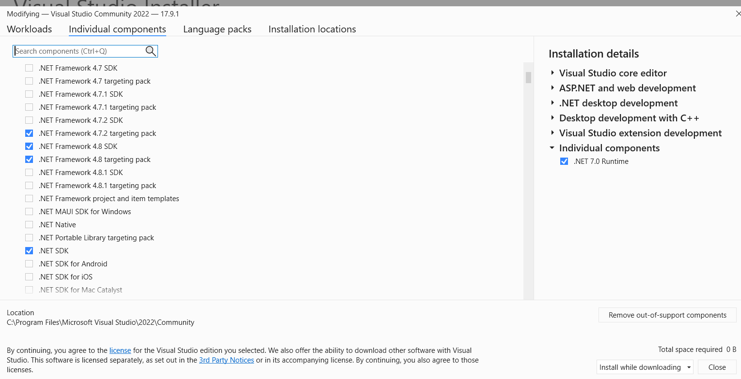

Slide 7
